Slide 1
Yield-Per-Recruit
Does your fishery achieve high yields?

Slide 2
YPR is used to determine if higher yields will result from catching fish when they are:
Younger & Smaller & Plentiful
Older & Larger but Fewer
OR

Slide 3
To calculate YPR, we must understand two aspects of fish biology:
Fish natural mortality
(death) rate
Fish growth rates in length and weight

Slide 4
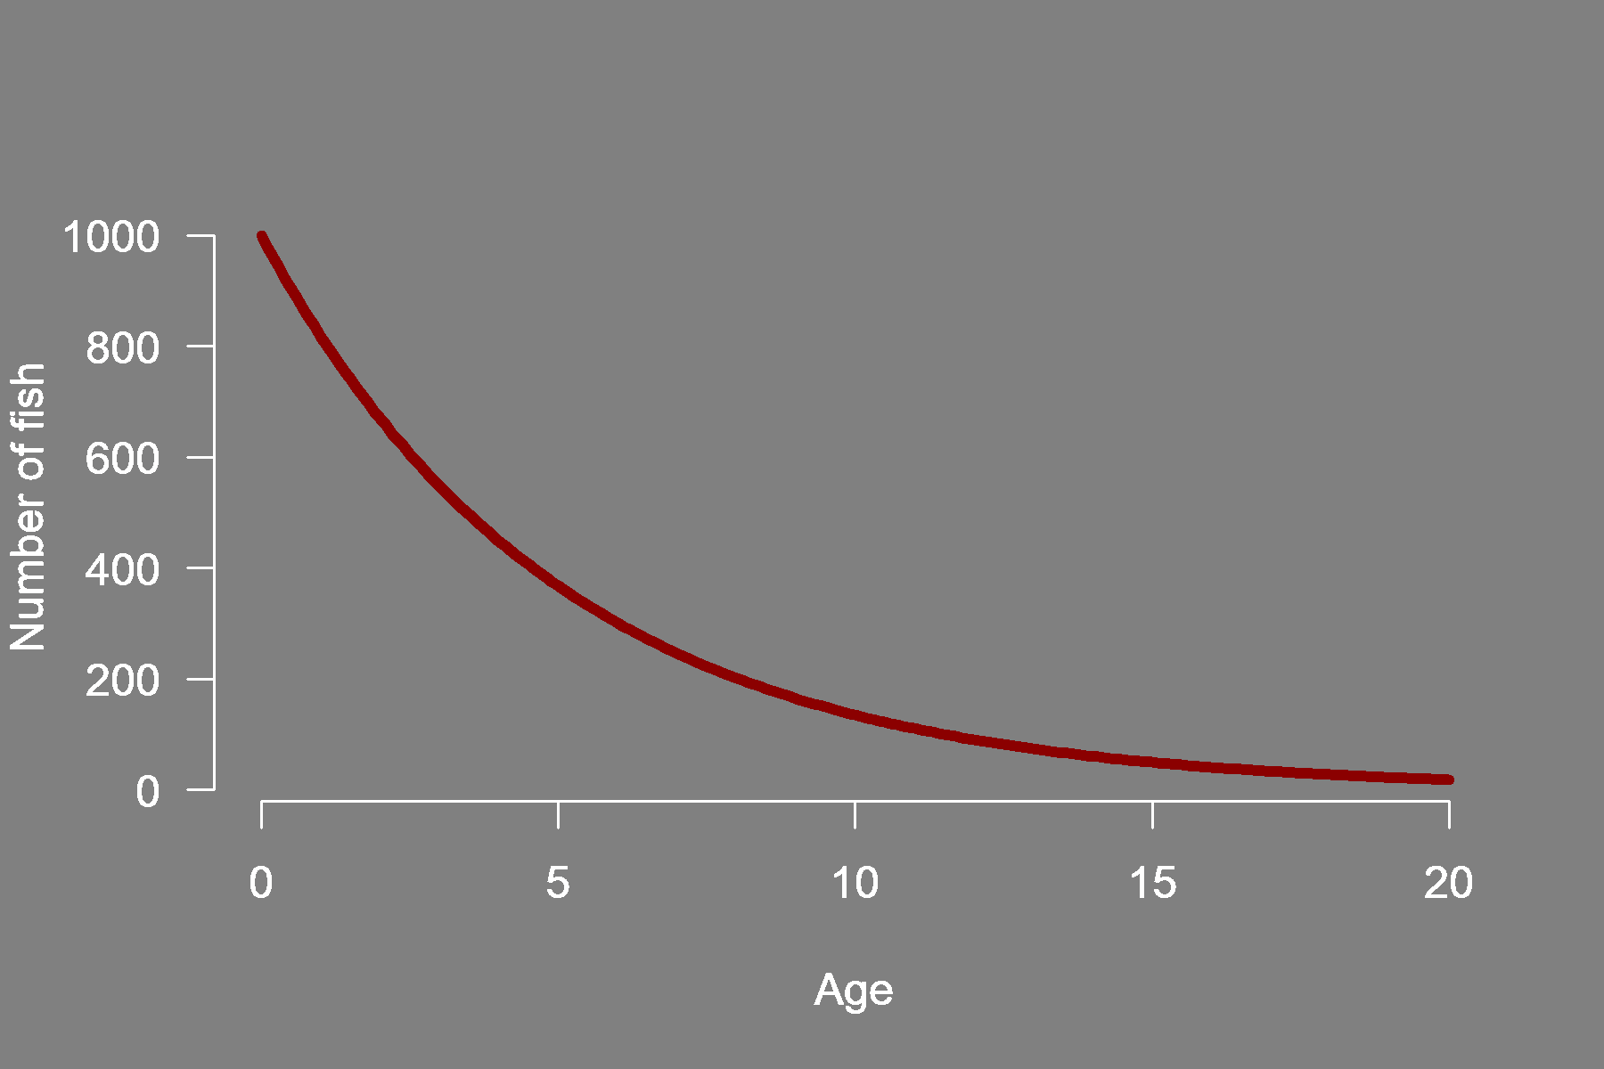
Catch them before they’re gone?
Natural mortality
Fish die out naturally over time
As a cohort of fish ages, the number of fish decreases

Slide 5
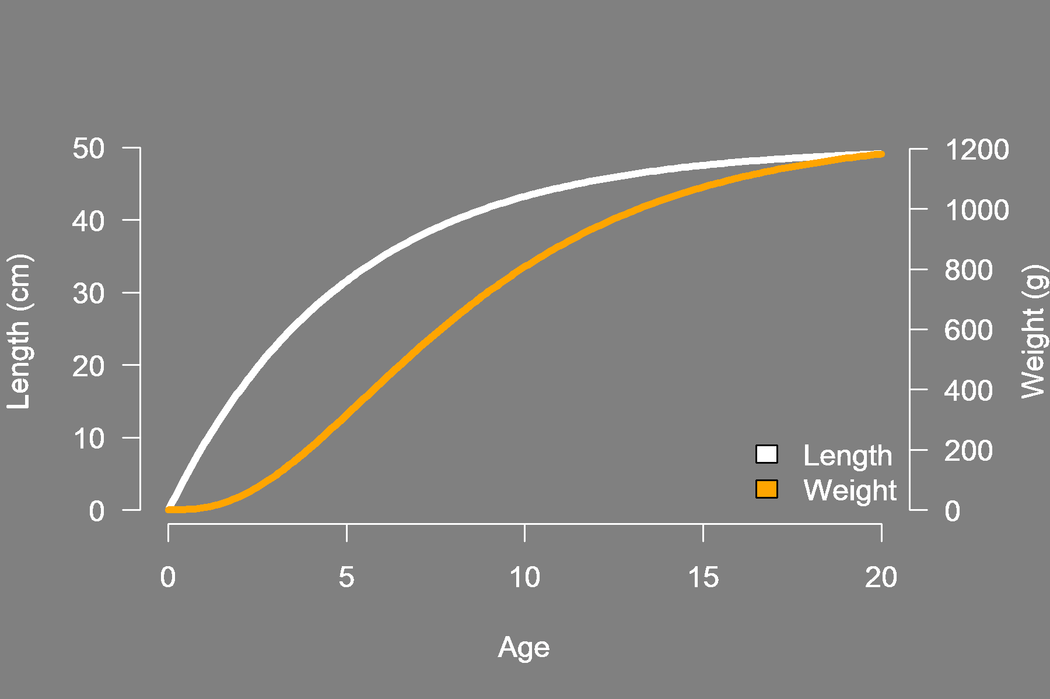
Or wait, and let them grow?
Growth in length and weight
As a cohort of fish increases in age, their average size increases
Length and weight will often level off at the oldest ages

Slide 6
Fish biology presents a dilemma for fishers:
To maximize the weight of the harvest we must wait and let the fish grow
But how long should we wait?

Slide 7
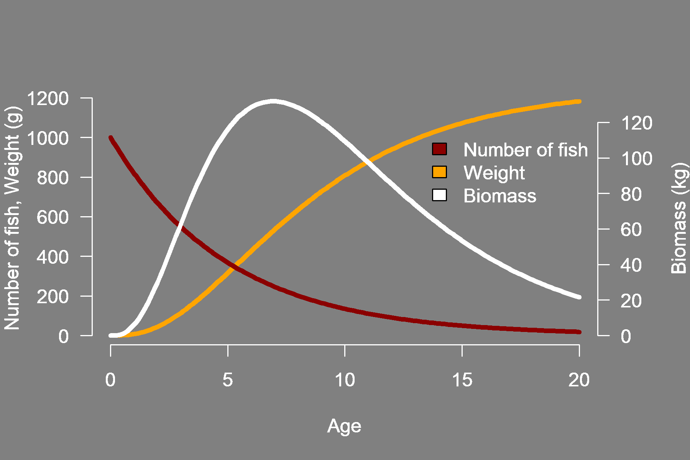
Biomass - combines number of fish and weight of fish
Biomass changes as a cohort ages
As fish grow in weight, cohort biomass increases → It is wise to wait
But wait too long, and biomass starts to decline as fish naturally die out

Slide 8
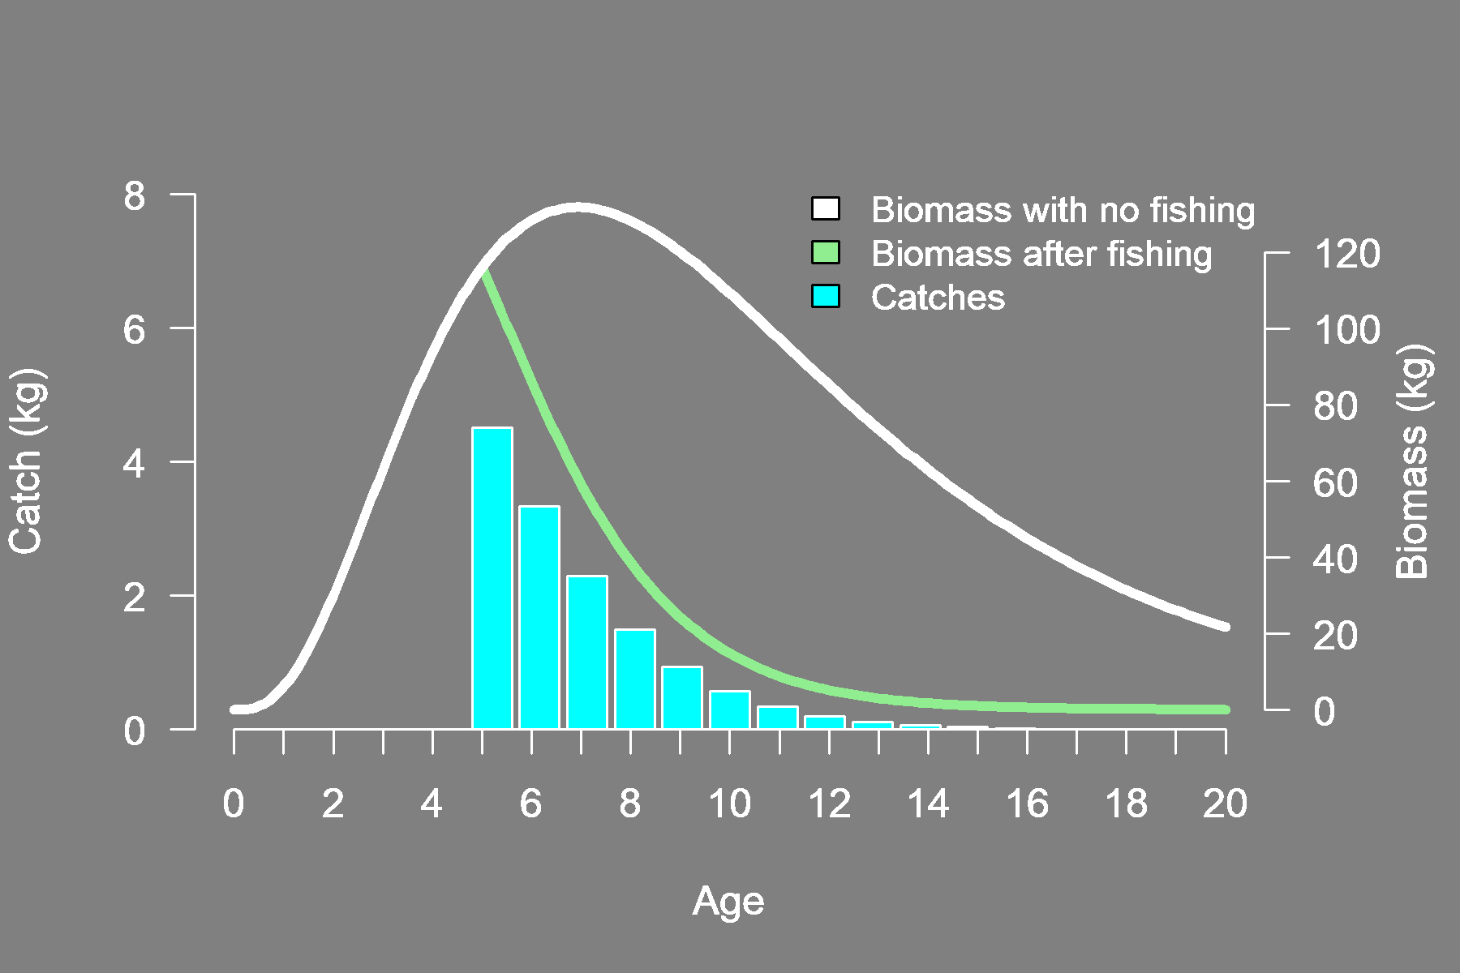
A calculation of fishery yield
In the bar plot above, fish begin to be caught at age 5
The blue bars show the catch in weight obtained each year across the cohort’s lifespan
Combined, the blue bars represent total yield of the cohort

Slide 9
Calculation of yield-per-recruit (YPR)
YPR
Total yield of the cohort
Initial cohort size (number of recruits)
Simply put, YPR standardizes yield relative to the initial size of the cohort

Slide 10
YPR has a variety of uses in fisheries management, including:
Comparing expected yield for different fishing practices
Delineating reference points for fishery management
Identifying which fishing practices will achieve higher yield

