Slide 1
Growth overfishing
Are too many fish being harvested at small sizes?
Recommended prerequisite:
Review “Yield-per-recruit” module

Slide 2
Growth overfishing:
Growth overfishing occurs when fishing effort is too high on size classes of young, small fish that are still rapidly growing.

Slide 3
An analogy from potato gardening
This is equivalent to
Growth overfishing
Removing small fish before they can reach higher weight results in lost yield.
Harvesting the potatoes early, when they are small, instead of waiting for full size potatoes.
Yield
Standing crop
Notes:
Say you plant potatoes. Harvesting them early at the size of golf balls instead of waiting for full size potatoes, when they may be the size of softballs, is equivalent to growth overfishing. Harvesting and eating all the potatoes this year, saving none to plant next year, is equivalent to recruitment overfishing.

Slide 4
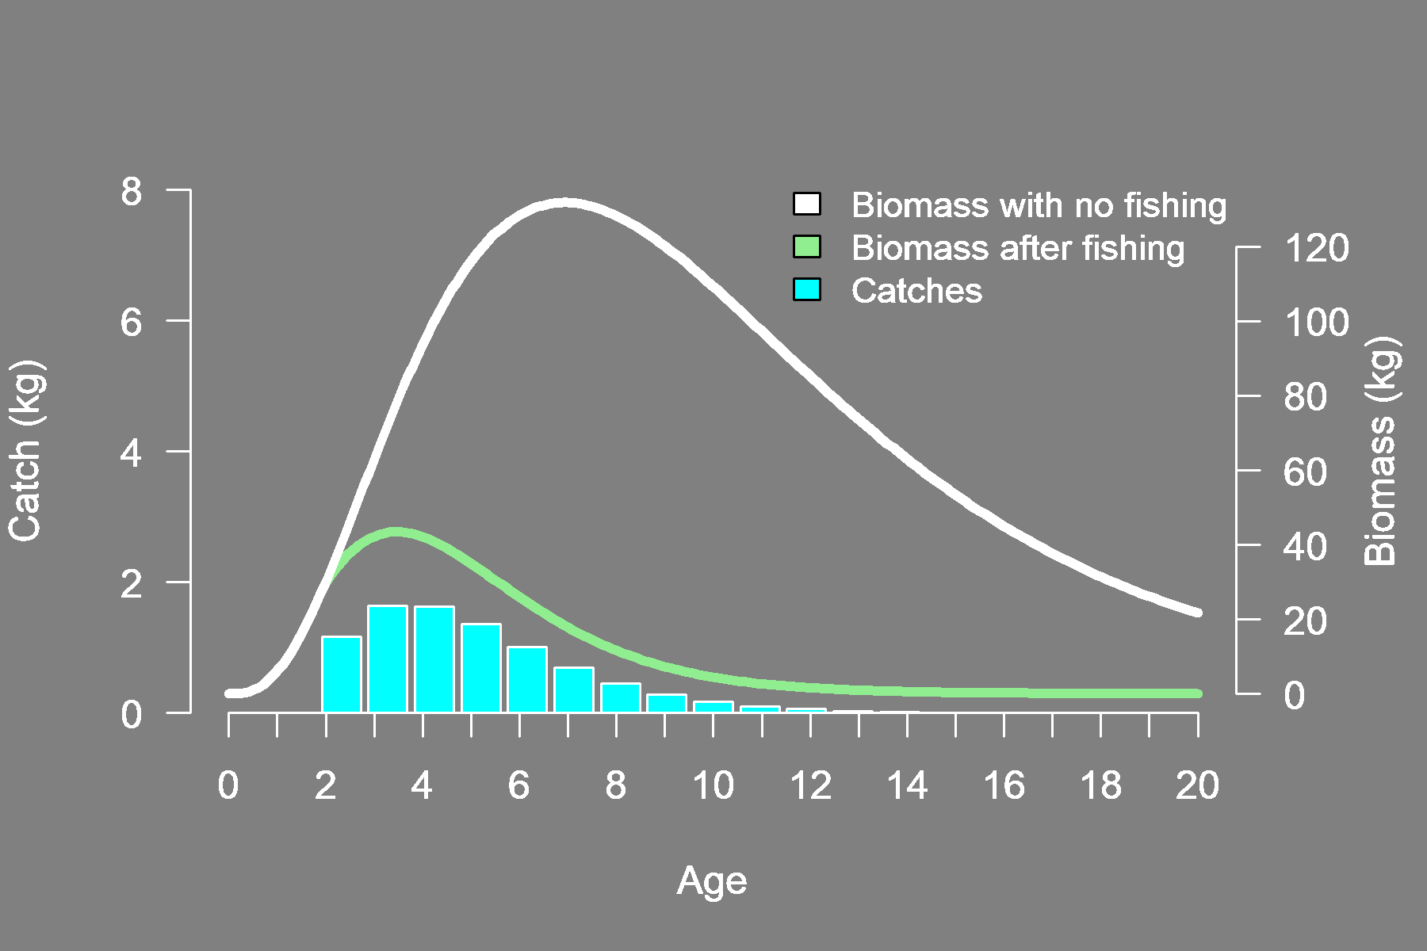
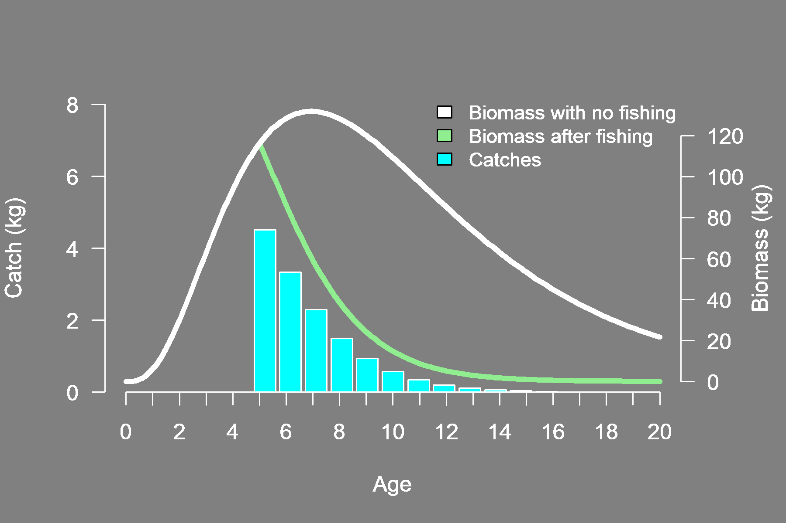
YPR calculated for two fisheries that differ in minimum age at capture
Minimum age at capture: 5
YPR = 0.12 kg / recruit
Minimum age at capture: 2
YPR = 0.08 kg / recruit
The fishery on the left allows younger fish to be caught, which results in lower total yield
Growth overfishing is occurring

Slide 5
YPR can be used to detect growth overfishing
Review
YPR
Total yield of the cohort
Initial cohort size
By standardizing yield relative to cohort size, YPR can be used to compare expected yield between fishing practices
When a fishery is capturing young fish, low yields can be an indication of growth overfishing

Slide 6
YPR Graph
By repeating YPR calculations over a sequence of minimum age at capture, we can build a relationship between these quantities.
Peak or maximum yield
Fish age converted to length

Slide 7
Example of Growth overfishing
For the fishery shown in the graph on the left, growth overfishing is occurring because the fishery is producing lower YPR than could otherwise be achieved.
Higher yields would result from only catching older and larger fish.
The fishery would be wise to consider an increase in the minimum size limit to achieve improved yields.

Slide 8
Growth overfishing can occur when:
A fishery fails to ensure that small fish reach larger sizes before harvest
A fishery exerts too much fishing effort on small fish

Slide 9
Growth overfishing can be remedied through:
Reduction of fishing effort, especially when catching smaller size fish is common
Modification of fishing practices to avoid small fish
Increase of the minimum size limit

