Slide 1
Life History Information
Which life history parameters are needed for YPR & SPR?
Recommended prerequisites:
Review “Yield-per-recruit” & “Spawning potential ratio” modules

Slide 2
Life history information:
Describes how a fish species grows, survives, and reproduces over time.
Fishery scientists use a variety of metrics and mathematical equations to characterize a fish species’ life history.

Slide 3
Why do we care about life history?
To understand characteristics of a specific species
Life history parameters are needed to conduct YPR and SPR analyses
Provides important insight for setting size limits

Slide 4
Four life history parameters are key to conducting YPR and SPR analyses:
Growth rate
K
Average maximum size
Linf
Natural mortality rate
M
Length at maturity Lm
How fast does the fish grow?
How large does the fish grow?
How fast does the fish naturally die out?
What is the length at reproductive maturity?

Slide 5
Growth
Fish tend to grow faster when they are young, with growth slowing and often leveling off at older ages

Slide 6
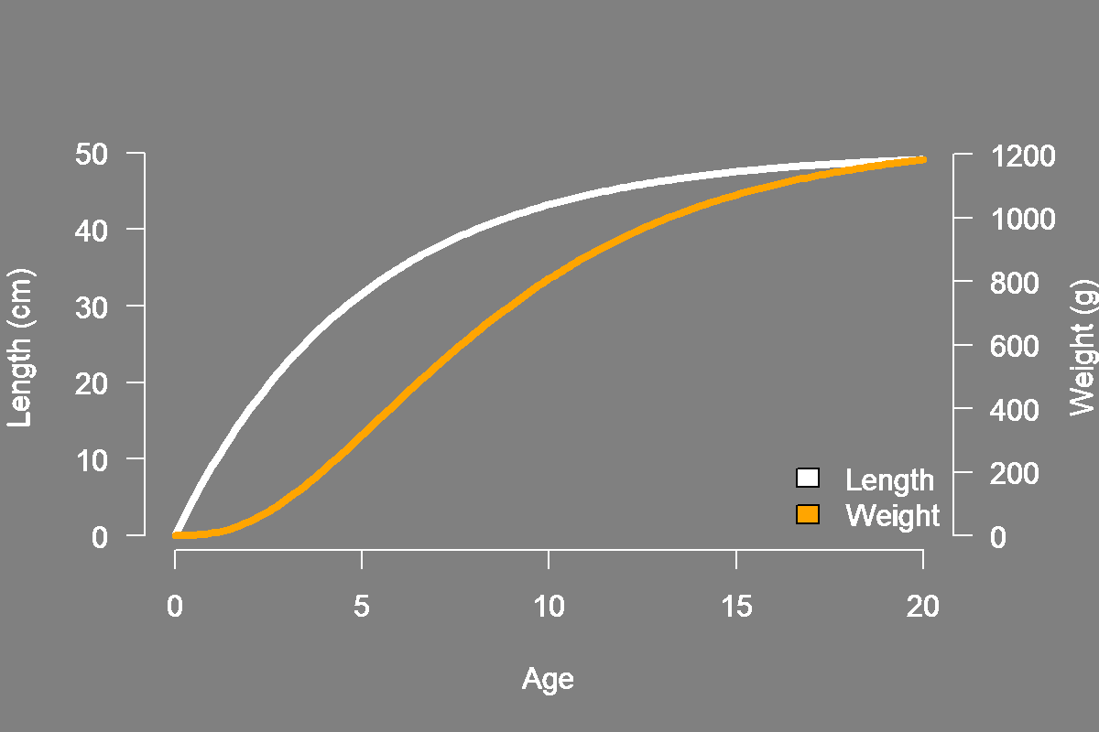
Growth in weight
Growth can also be expressed in weight
Weight increases with age and levels off at older ages

Slide 7
Growth rate - K
Growth coefficient
Fishery lexicon: K
The growth coefficient, K, determines the curvature of the growth curve and tells us how quickly average maximum size is reached

Slide 8
Average maximum size - Linf
Average maximum size
Fishery lexicon: Loo, Linf
(pronounced: “L-infinity”)
Linf is not the longest fish ever observed but rather the average maximum length of the species

Slide 9
Species comparison - Growth
Species B
Species A
Growth rates vary between species
The two example species above reach the same average maximum size, but differ in the curvature of the growth relationship

Slide 10
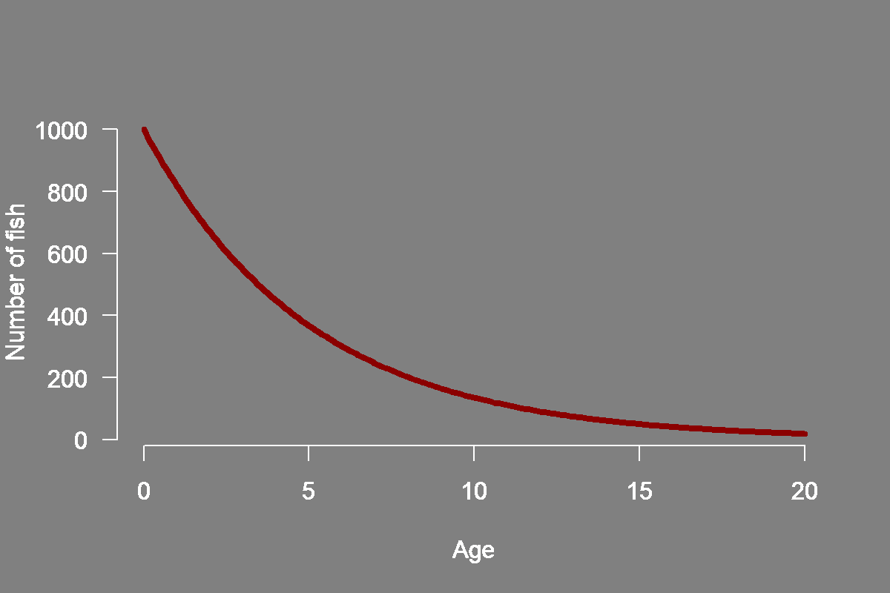
Natural mortality
Natural mortality is the loss (death) of fish by causes other than fishing
The plot shows a cohort that begins with 1,000 fish
The line illustrates the number that survive to each successive age

Slide 11
Natural mortality rate - M
Natural mortality rate
Fishery lexicon: M
The natural mortality rate determines how quickly a cohort of fish will naturally decline

Slide 12
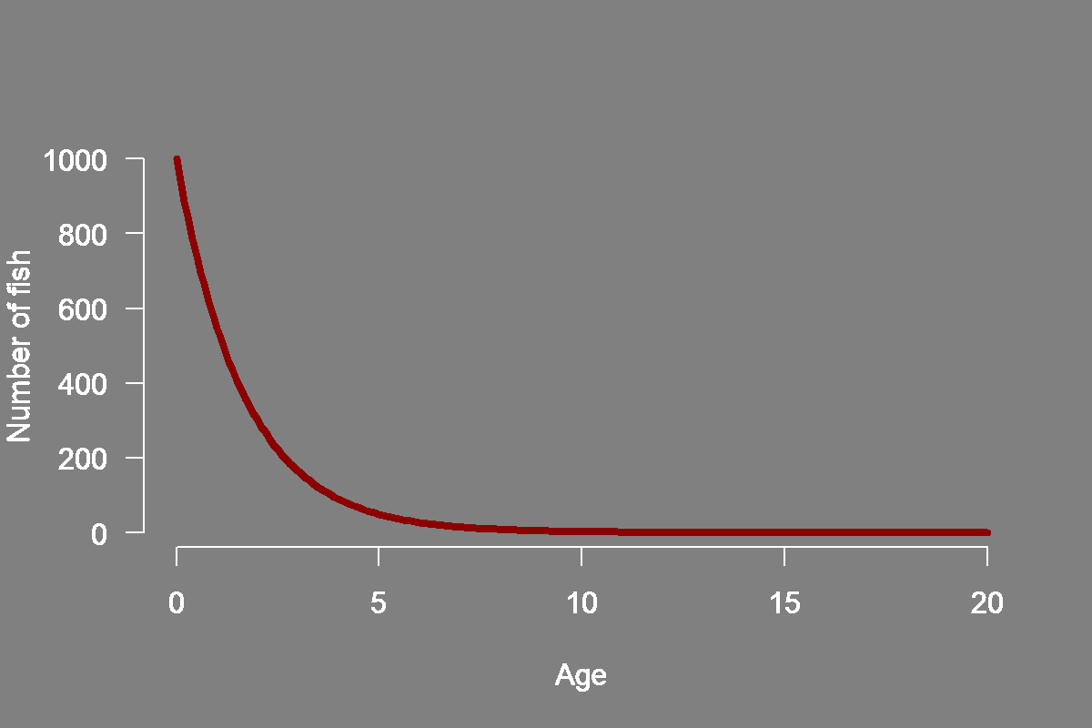
Species comparison - Natural mortality
Species B
Species A
Natural mortality rates vary between species
In the above examples, Species B naturally dies out at a faster rate than Species A

Slide 13
Length at maturity
Eggs
Juvenile fish
Length at maturity
Maximum length
The length at which a fish species reaches sexual maturity and is able to reproduce

Slide 14
Length at maturity - Lm
Length at maturity
Fishery lexicon: Lm, L50, ‘size at maturity’
In the example above, the species reaches sexual maturity at a length of ~32cm (~age 5)
It if useful to consider length at maturity in relation to other facets of life history, like growth
This allows for improved understanding of juvenile and adult life stages

Slide 15
Life history groupings
Example: Anchovy
Earlier maturity
Faster growth
Shorter lifespan
Higher natural morality
Later maturity
Slower growth
Longer lifespan
Lower natural mortality
Example: Sturgeon
Fish species often share similar sets of life history characteristics, allowing similar species to be grouped together
Grouping allows knowledge gaps in life history characteristics to be explored and filled

Slide 16
Life history information plays a central role in fisheries management, including:
To understand the importance of, and variability in, different species’ characteristics
To conduct
SPR and YPR analyses
To provide insights needed for setting size limits

