Slide 1
Size Limits
How can a size limit help manage your fishery?
Recommended prerequisites:
Review “Growth Overfishing” & “Recruitment Overfishing” modules

Slide 2
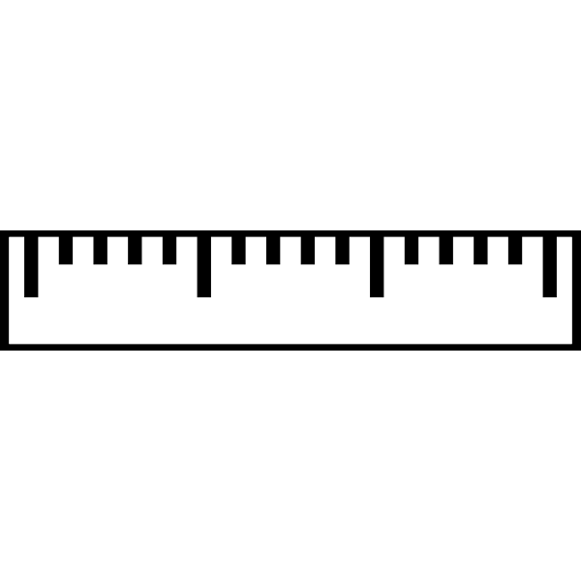
A minimum size limit is the minimum length a fish must be to be legally harvested

Slide 3
Minimum size limits allow fish to grow before becoming vulnerable to fishing. Doing so can produce higher yields.
Review
Minimum size limits can help to avoid
growth overfishing

Slide 4
Allowing fish to reach maturity before becoming vulnerable to fishing can help ensure population replenishment.
Review
Minimum size limits can help to avoid recruitment overfishing

Slide 5
A Fishery with a Minimum Size Limit
Able to spawn before becoming vulnerable to fishing
Juvenile
Mature
Off limits to fishing
Legally fished
Minimum size limit

Slide 6
A slot limit is another type of size limit
A slot limit constrains both the minimum and maximum lengths that can be legally harvested.

Slide 7
A harvestable slot limit specifies a size range (minimum and maximum) within which fish may be legally harvested.
Slot limits can help to protect both immature fish and mega-spawners
Notes:
A protected slot limit specifies a size range (both minimum and maximum) that prohibits take within the interval. Alternatively, harvestable slot limits define an interval within which take may occur.

Slide 8
A Fishery with a Slot Limit
Able to spawn before becoming vulnerable to fishing
Mega-spawners protected
Juvenile
Mature
Off limits to fishing
Legally fished
Off limits to fishing
Slot limit

Slide 9
Why consider a minimum size limit?
If fish are caught before they reach maturity, they will not spawn and produce offspring, and the population will decline.
By setting the minimum size limit at or above length at maturity, individual fish are able to spawn before becoming vulnerable to fishing.

Slide 10
Why consider a slot limit?
Fish are able to grow and reach maturity before becoming vulnerable to fishing.
Larger fish tend to produce more eggs and replenish the population at a higher rate; slot limits can help to ensure that these larger fish are protected.
Notes:
Given that larger fish of a given species tend to produce more eggs and replenish the population at a higher rate, slot limits can help ensure that these larger fish are also protected (Barneche et al. 2018). Additionally, since fishers, especially recreational fishers, often target larger, “trophy” catches, slot limits can help prevent size truncation across a population as a result of this preference (Gwinn et al. 2015). Some research has shown that slot limits can oftentimes outperform minimum size limits for optimizing both biomass and yield (Ahrens et al. 2020).
Fish are able to grow and reach maturity before becoming vulnerable to fishing.

